Slide 1

Design Sprint Foundations
Project 3: The Prototype

Slide 2


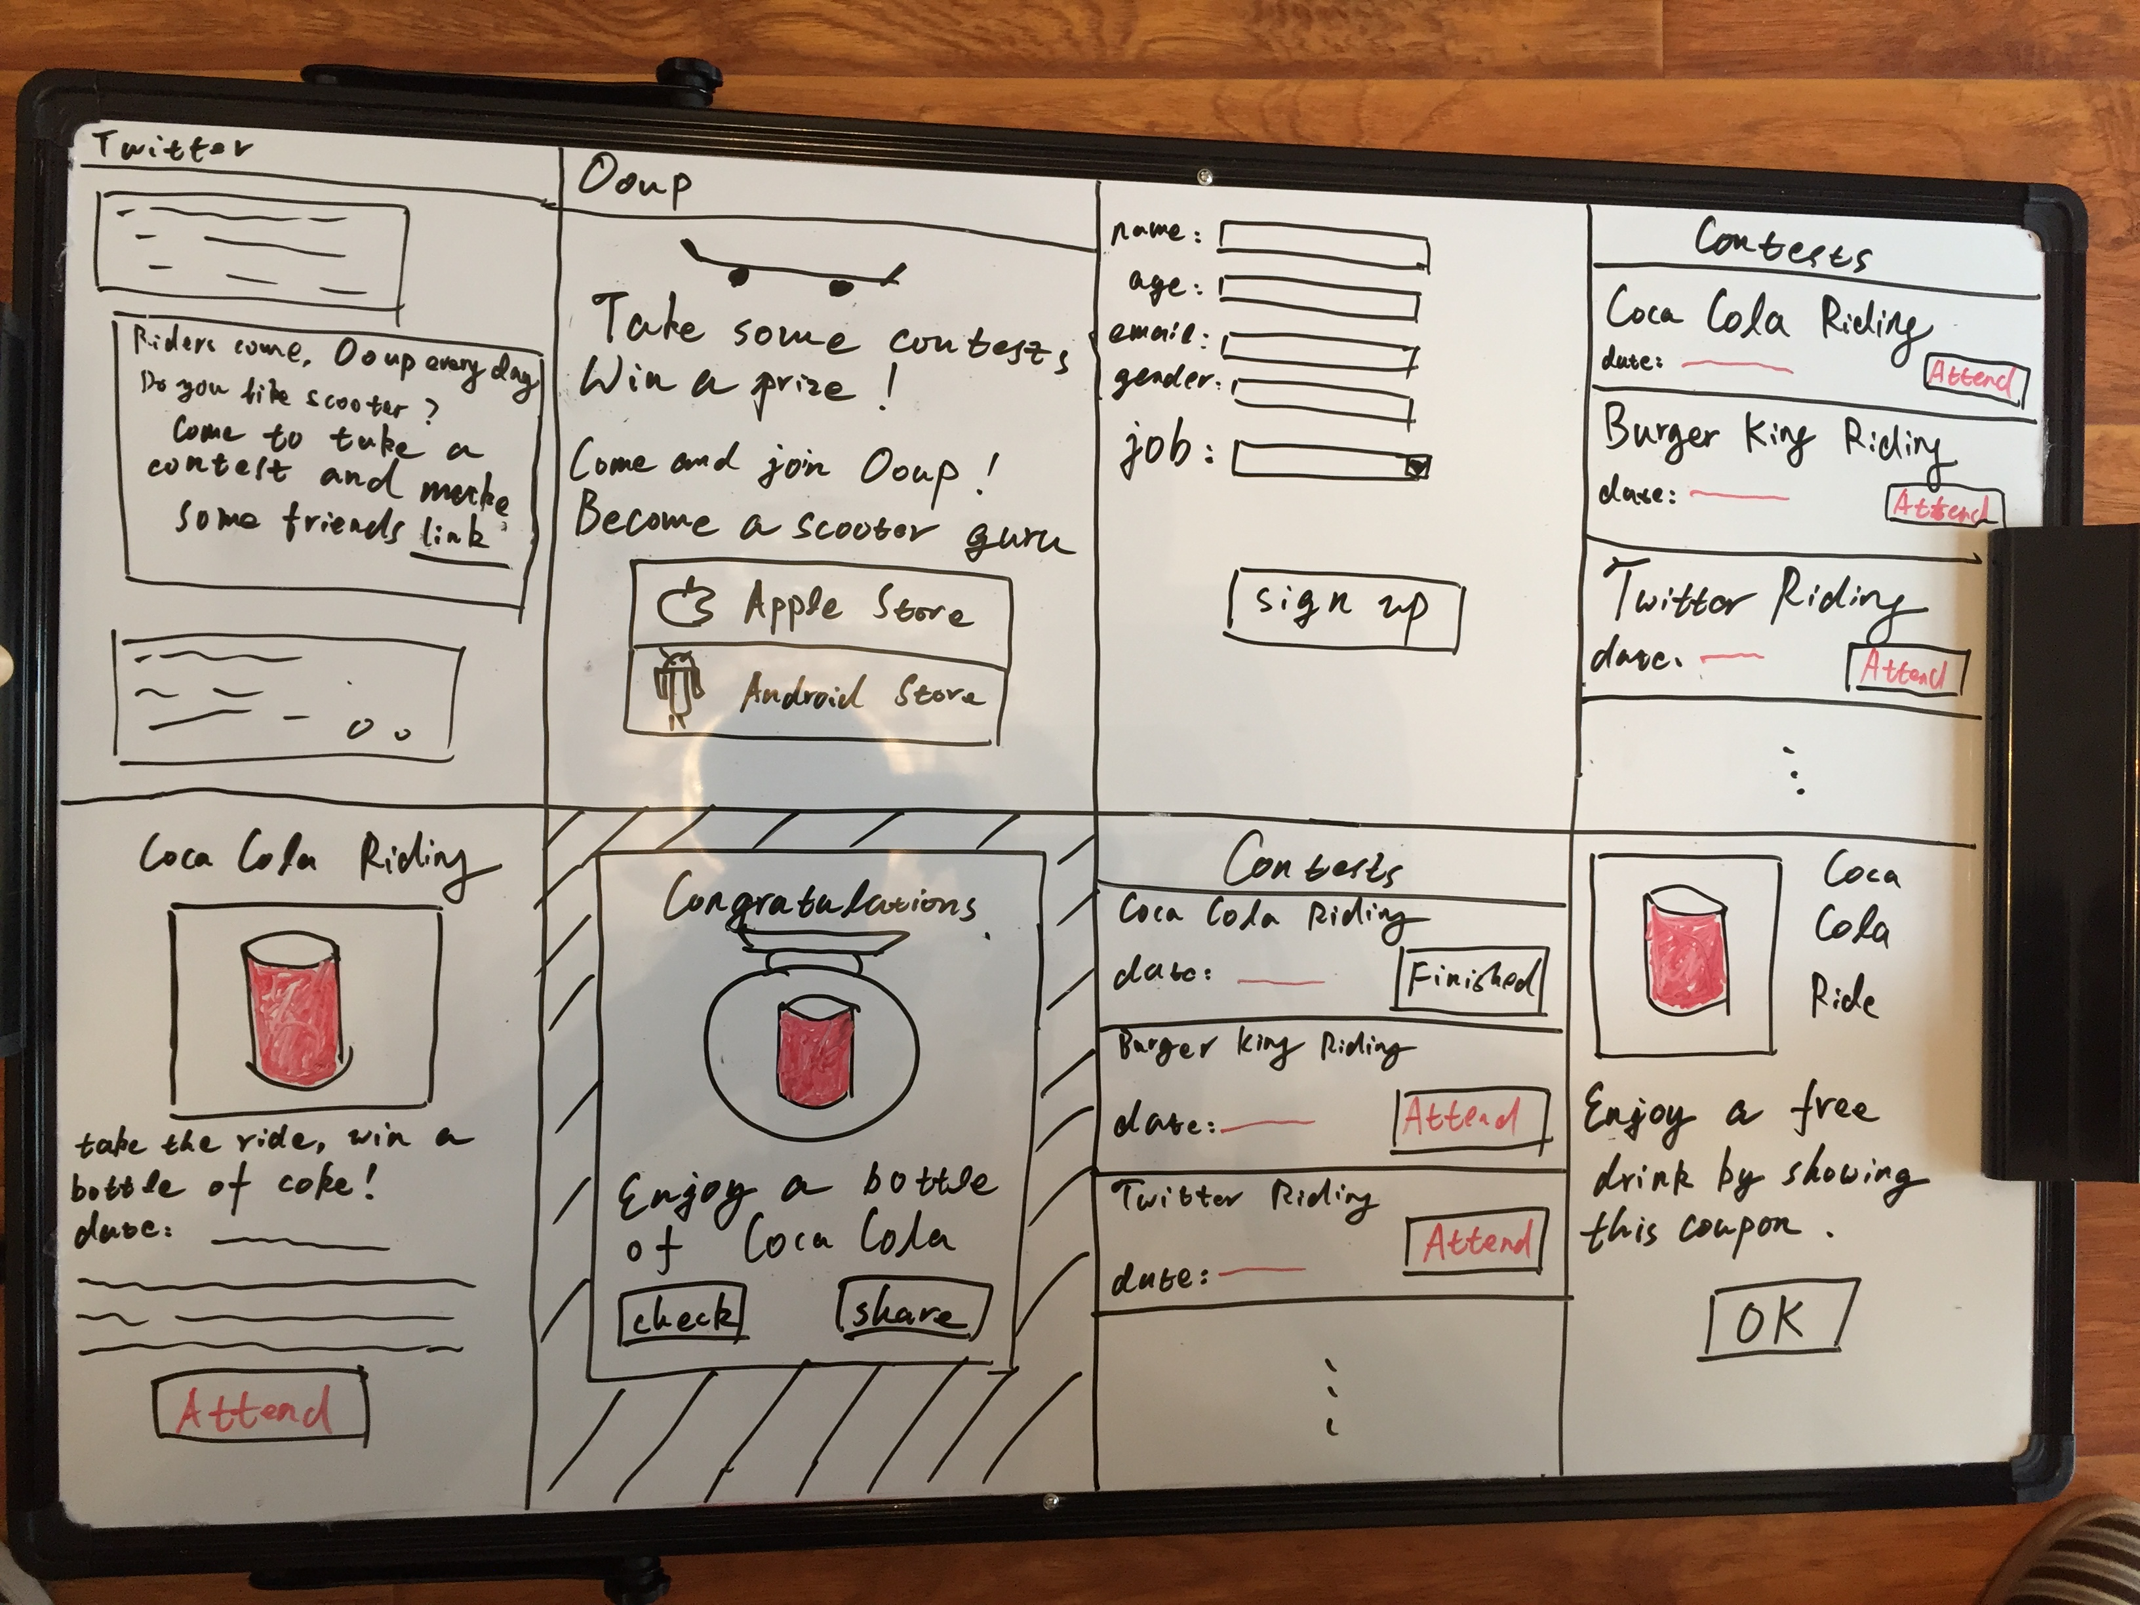
STORYBOARD FOR REFERENCE
insert actual image
Description goes here

Slide 3

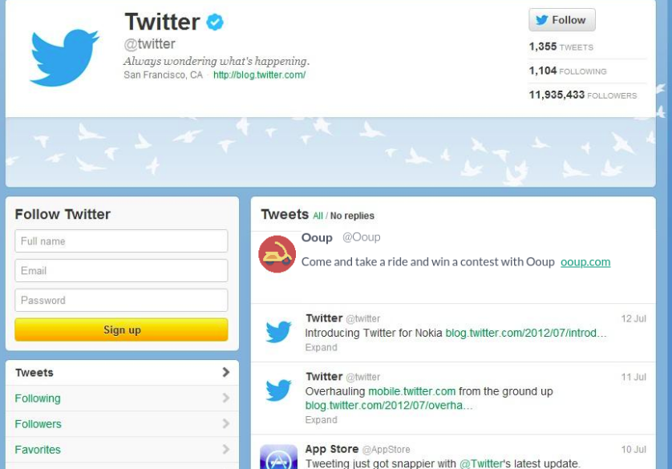
TEMPLATE FOR DESKTOP EXPERIENCE
make a copy for each screen of your Prototype
insert actual image
Description goes here

Slide 4
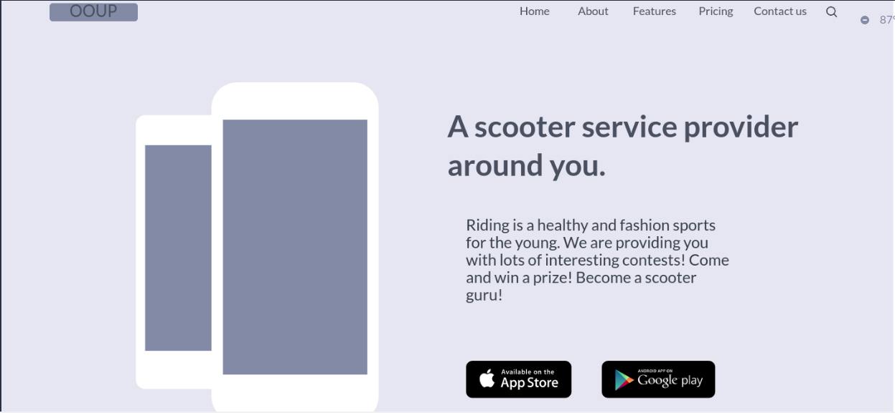

TEMPLATE FOR DESKTOP EXPERIENCE
make a copy for each screen of your Prototype
insert actual image
Description goes here

Slide 5
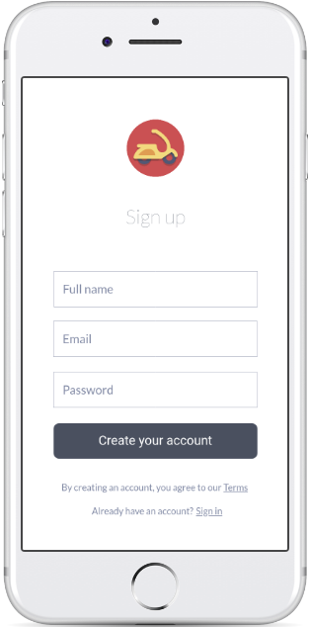
TEMPLATE FOR MOBILE EXPERIENCE
make a copy for each screen of your Prototype
Description goes here

Slide 6
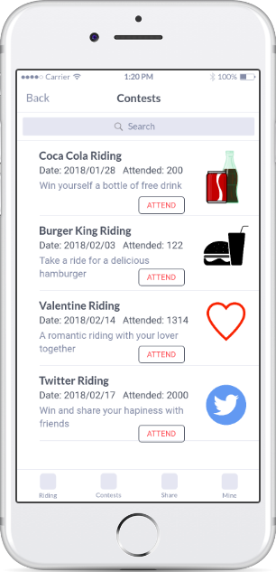
TEMPLATE FOR MOBILE EXPERIENCE
make a copy for each screen of your Prototype
Description goes here

Slide 7
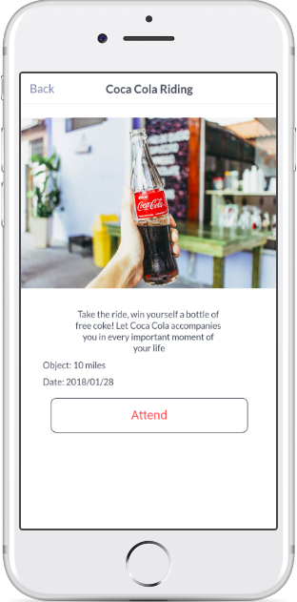
TEMPLATE FOR MOBILE EXPERIENCE
make a copy for each screen of your Prototype
Description goes here

Slide 8
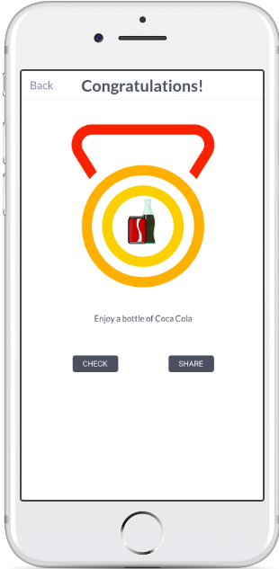
TEMPLATE FOR MOBILE EXPERIENCE
make a copy for each screen of your Prototype
Description goes here

Slide 9
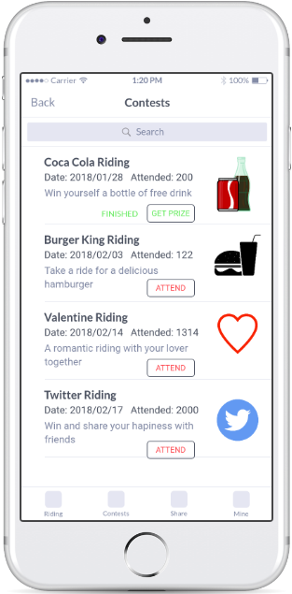
TEMPLATE FOR MOBILE EXPERIENCE
make a copy for each screen of your Prototype
Description goes here

Slide 10
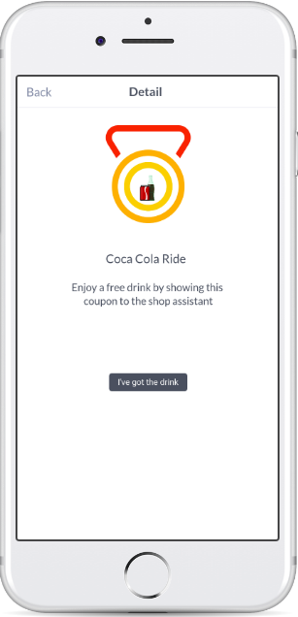
TEMPLATE FOR MOBILE EXPERIENCE
make a copy for each screen of your Prototype
Description goes here

